Slide 1
Big Game Census Analytics

Slide 2
Introduction
Objective:
To explore the birthplaces of Super Bowl 52 players in relation to state population data.
Inspiration:
Developed by two data enthusiasts after their teams were eliminated from the playoffs.
Data Source:
Census data from census.gov and roster information from Yahoo Sports.

Slide 3
Methodology
Data Collection: Census data pulled from census.gov, roster information from Yahoo Sports. in
Data Integration: Merging of player birthplaces with state population data.
Visualization Platform: Designed using Power-BI.

Slide 4
Main KPIs
Number of Players per State
Players poistion and their age.
Latitude and Longitude by players name.

Slide 5
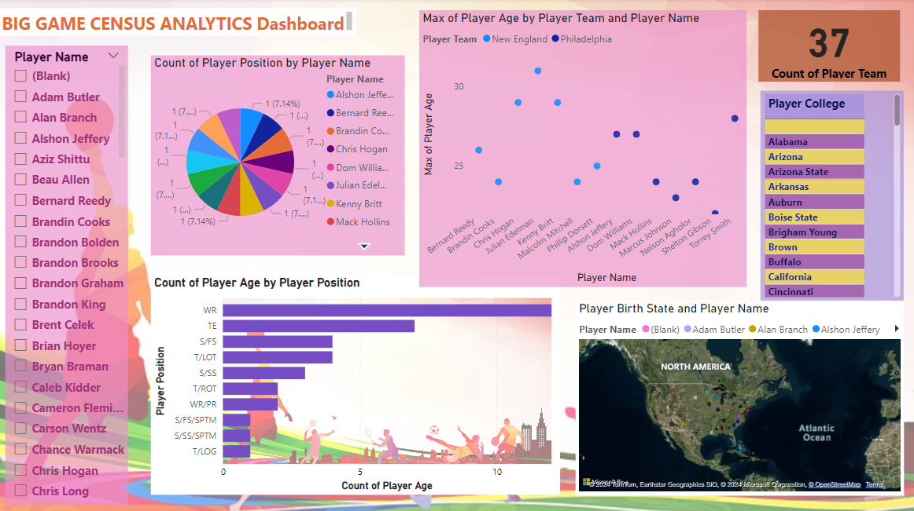
My Design

Slide 6
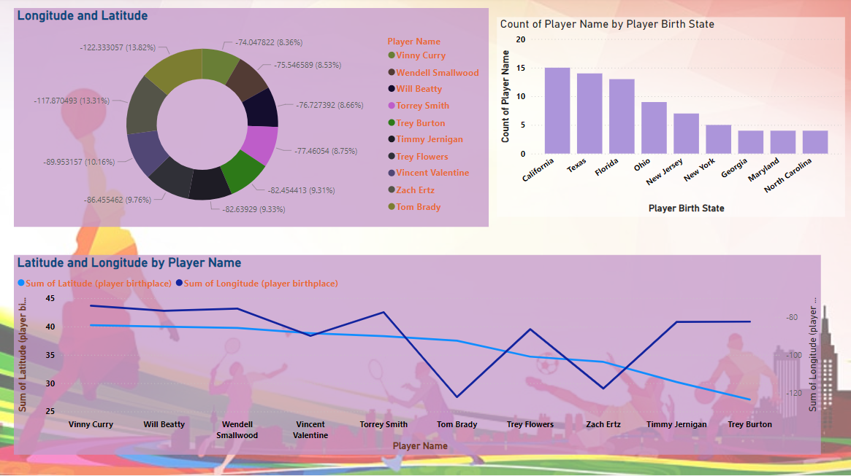

Slide 7
Thank You

